Slide 1

Access Control Application
Prepared by :
Abdallah Hamdan
Oluwatosin Fasanmi
Saajan Maharjan
Teacher: Majeed Jaber
May 15, 2023

Slide 2
Outline
Introduction
Hashing Overview
Methodolgy
Demonstration
Conclusion

Slide 3

Introduction
Access control restricts access to resources based on user/device identity in enterprise networks.
Access control misconfiguration is a common cause of data breaches, often exploited by threat actors targeting privileged users.
The 2021 Verizon Data Breach Investigations Report states that access control misconfiguration is the second most common cause of data breaches.
Weak or stolen passwords are also major causes of data breaches.
Hash authentication uses a one-way mathematical function to convert passwords into an unreadable format, adding an additional layer of security to access control.
Additional authentication measures can be implemented to ensure only authorized personnel have access to sensitive resources, reducing the risk of data breaches due to access control misconfiguration.

Slide 4
HASHING
Hashing is a mathematical method used in cryptography that converts data into a fixed-length bit string, creating a confused mess.
Hash functions have two crucial characteristics: they are easy to compute, but difficult or impossible to re-generate the original input from the hash value alone, and it's hard to create an initial input that would match a specific output.
Hashing is a one-way mechanism and different hashing algorithms like MD5, SHA256, and Bcrypt are used to provide one-way scrambling.
Hash implementations use salt to further randomize input, ensuring a different hashed password each time and protecting against hash function flaws.

Slide 5
Methodology
The project used bcrypt for password hashing, which involves padding the password, generating a random salt value, and hashing the combined password and salt 12 2^12 (4096) times iteration using the Blowfish encryption algorithm.
The use of random salt and multiple iterations makes bcrypt resistant to brute force and dictionary attacks.
The project included a pre-configured root account with credentials stored in an XML file, and additional accounts could be created through the application.
Upon authentication, the application redirects to a directory listing page with read-only access to specified directories.

Slide 6
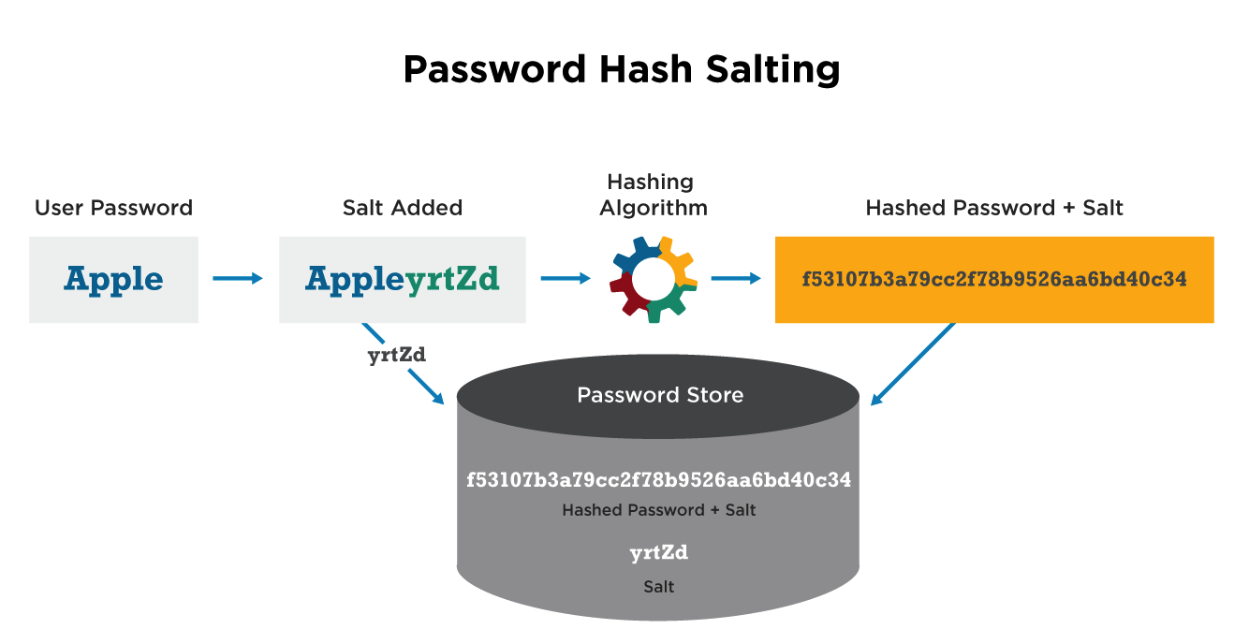
Methodology

Slide 7
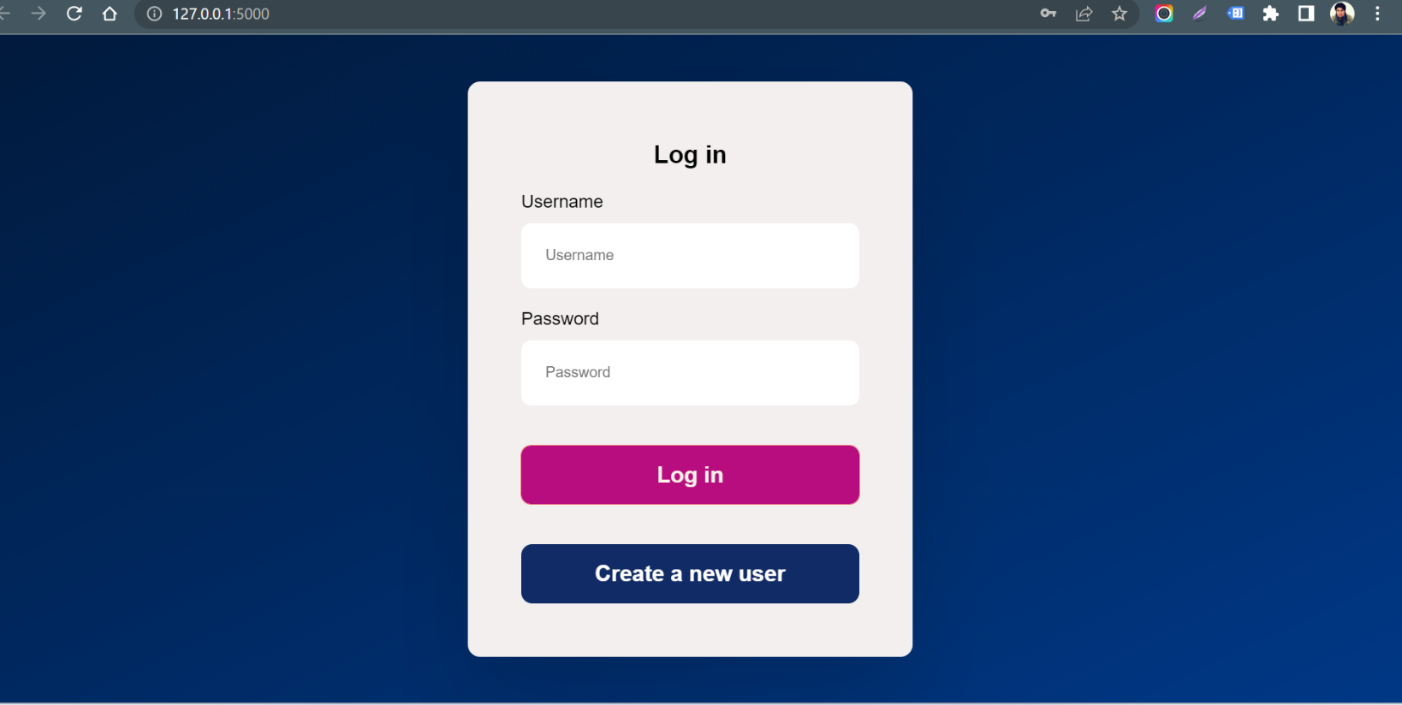
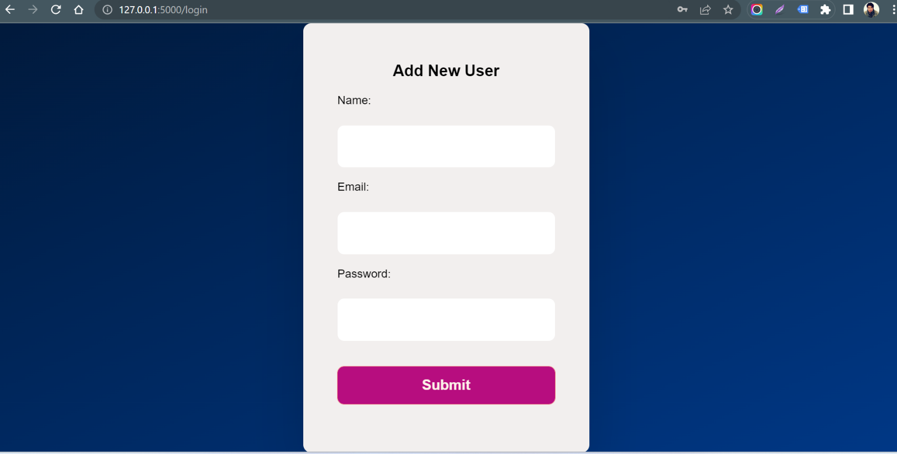
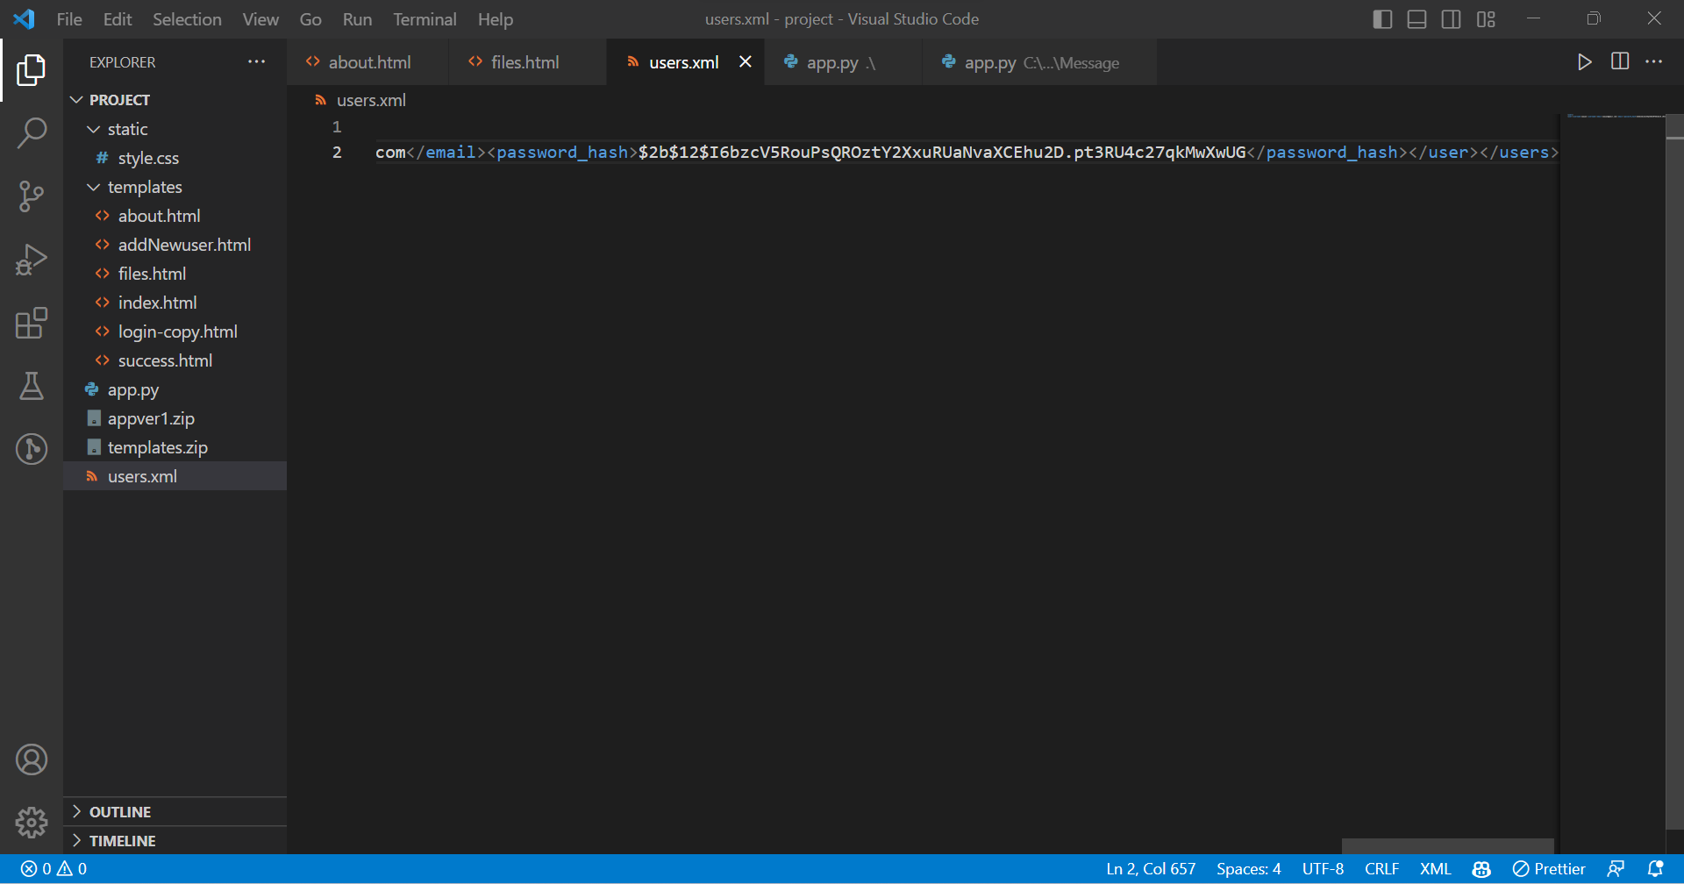
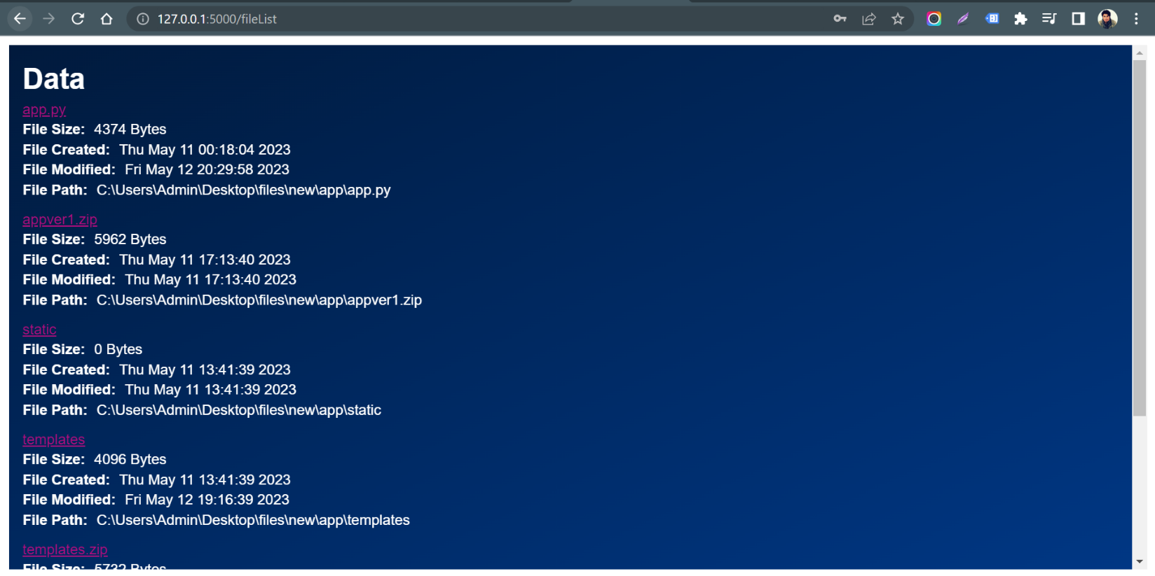
Demonstration Part

Slide 8
Conclusion
Access control is crucial for securing enterprise networks
Access control misconfiguration is a common cause of data breaches
Hash authentication adds an additional layer of security to access control
Bcrypt is a popular algorithm used for hash authentication
The project involved pre-configuring a root account and creating additional accounts with hashed passwords stored in an XML file
The application can be implemented independently of the underlying operating system or file system.
It can be used to control access to resources on any platform or device that supports web access.

Slide 9

Thank You

